Slide 1
Following slides are for reference not to be used as requirements

Slide 2
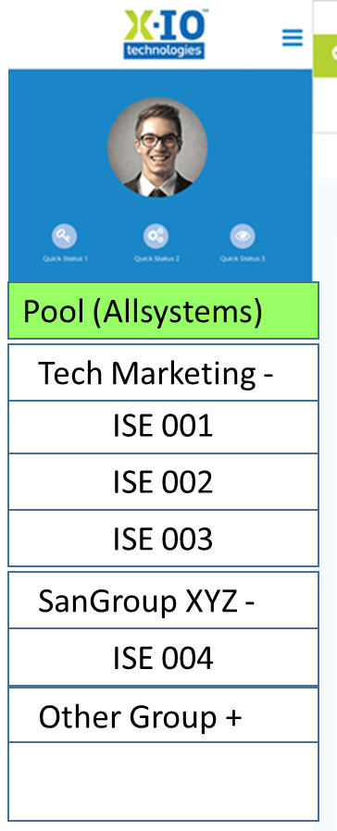
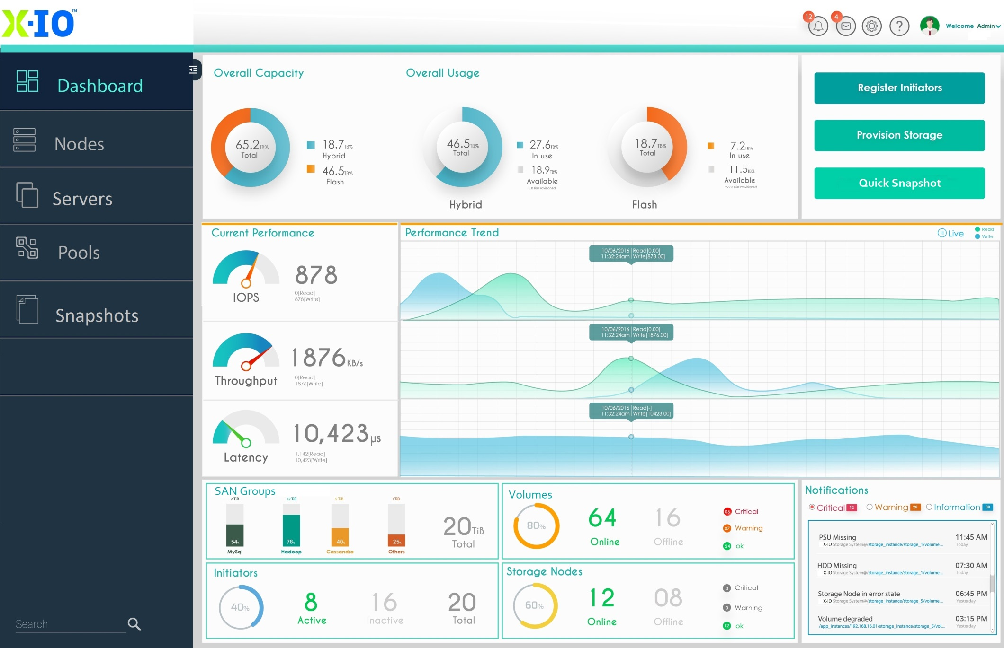
Dashboard - “Landing Page”
Dashboard
Dashboard
Storage
Performance
System
Default – Overall
List aggregate for all systems defined

Slide 3
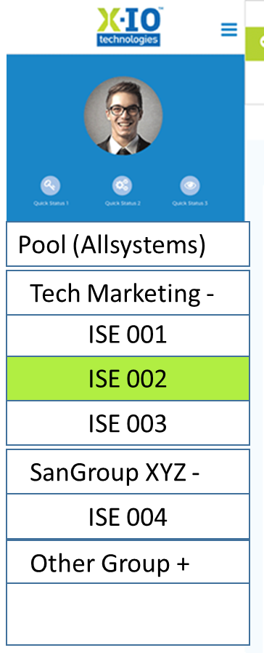
Dashboard - “User selected”
Dashboard
Dashboard
Storage
Performance
System/Devices/Maint
User can pick
List properties for selected system only

Slide 4
Dashboard - “User selected”
Dashboard
Dashboard
Storage
Performance
System
User can pick
List properties for selected system only

Slide 5
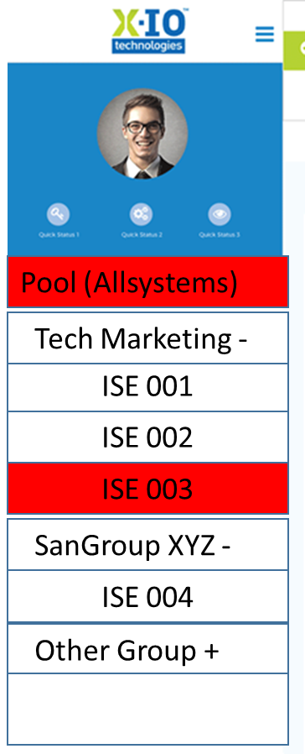
Dashboard
Dashboard
Storage
Performance
System

Slide 6
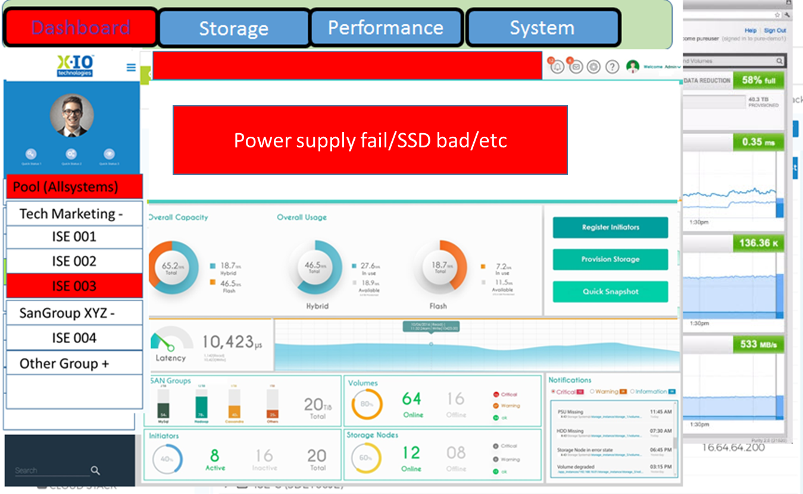

Slide 7
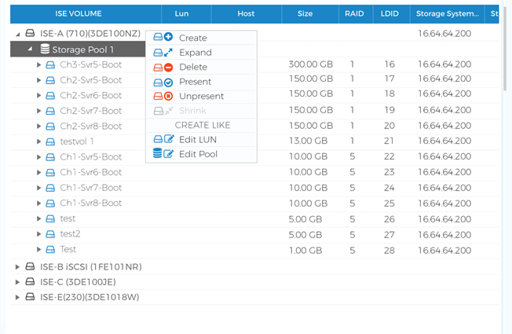
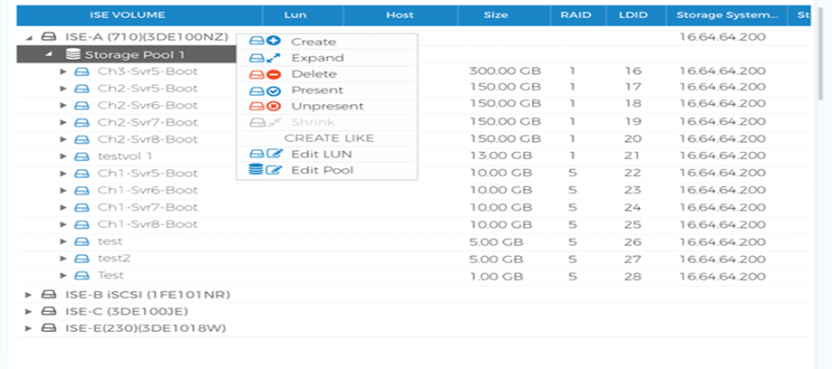
Dashboard
Dashboard
Storage
Performance
System
Hosts widget
Select to provision
Select ISE or any
ISE widget
Select ISE
Create vol - assign

Slide 8
ISE widget Select ISE Create vol - assign
Dashboard
Dashboard
Storage
Performance
System

Slide 9
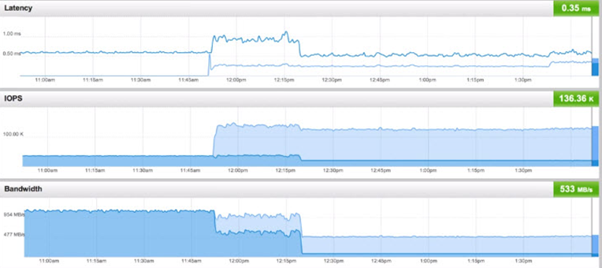
Dashboard
Dashboard
Storage
Performance
System
Longer trending
hover detail
click through to vol

Slide 11
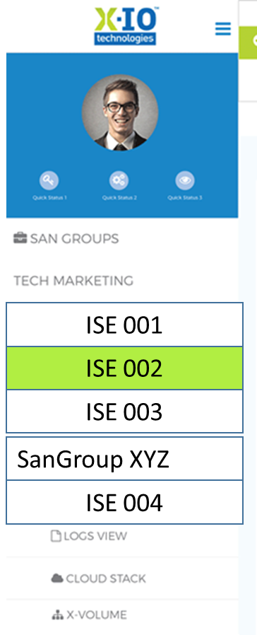
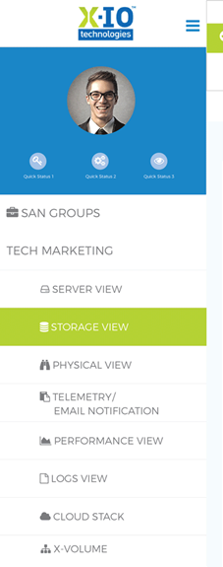
Dashboard
Dashboard
Storage
Performance
System

Slide 12
Dashboard
Dashboard
Storage
Performance
System

Slide 13
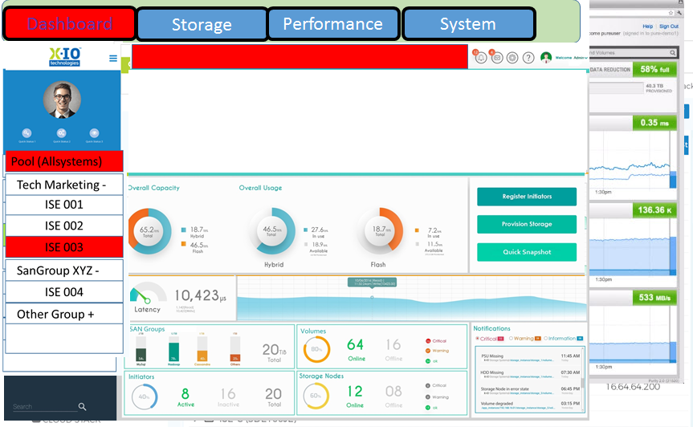
Power supply fail/SSD bad/etc

Slide 14
Dashboard
Dashboard
Storage
Performance
System

Slide 15
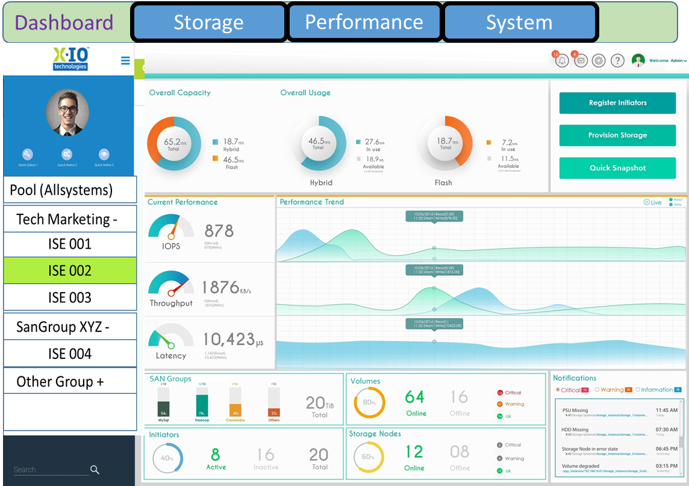

Slide 16
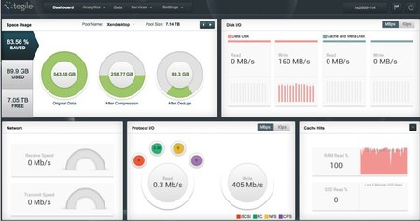

Slide 17
Sample High Fidelity Dashboard

Slide 18
Sample High Fidelity Dashboard

Slide 19
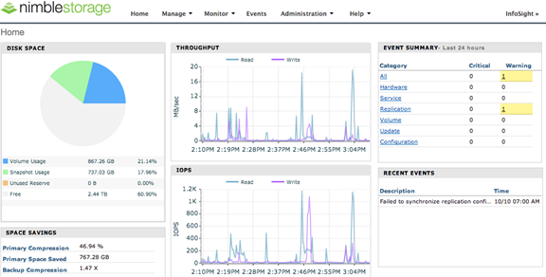

Slide 20
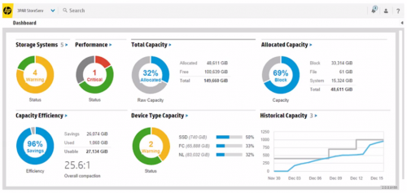

Slide 21
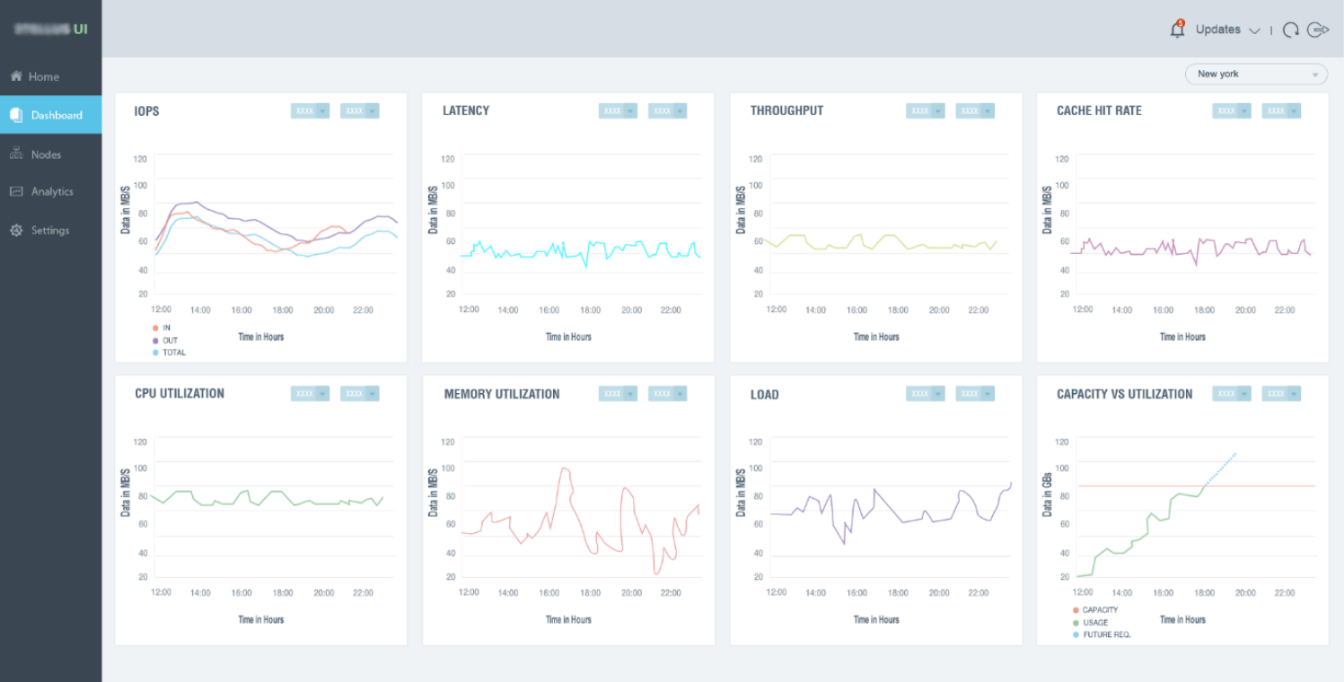

Slide 22
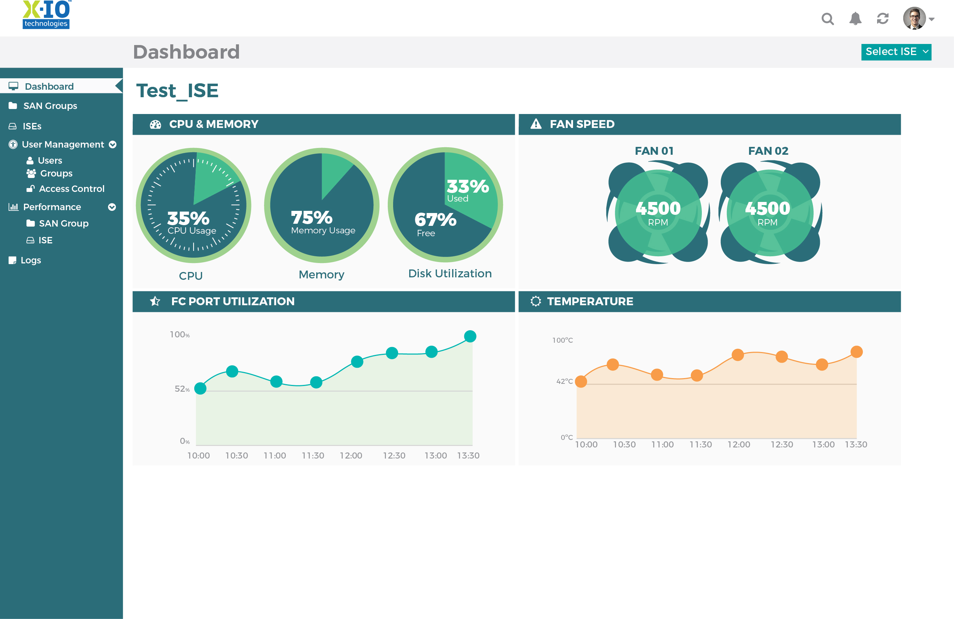
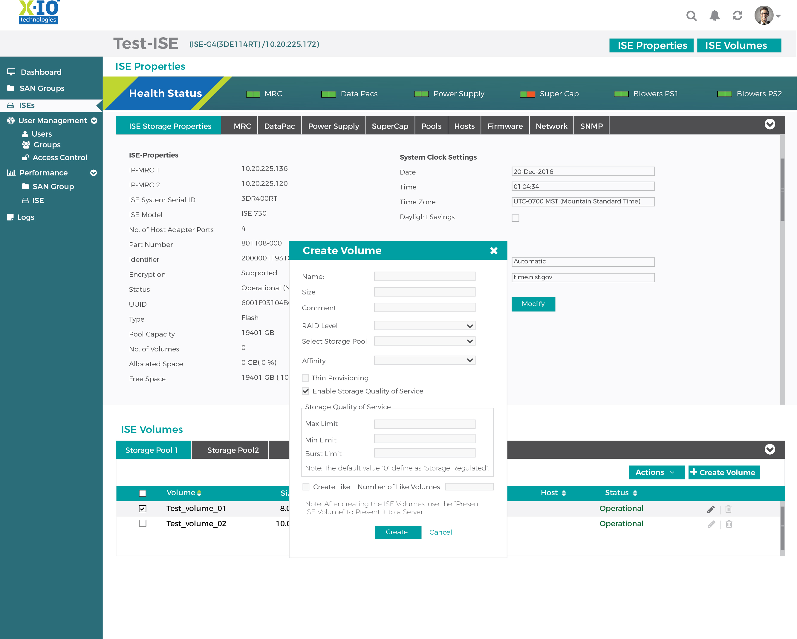

Slide 23
Dashboard
Storage
Performance
System

Slide 24
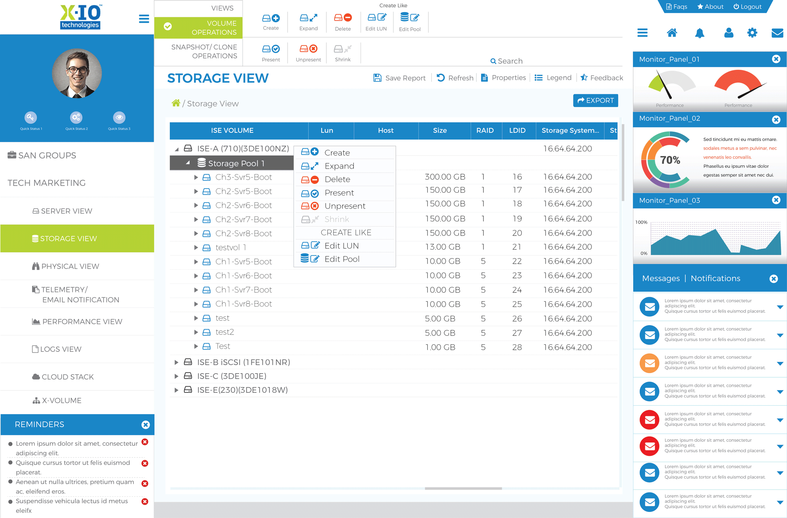

Slide 25

Pool (Allsystems)
Tech Marketing -
ISE 001
ISE 002
ISE 003
SanGroup XYZ -
ISE 004
Other Group +

Slide 26
